Slide 1
Connecting Presidential Collections
Sheila Blackford, Librarian
Matthew Stephens, Web Developer
Amber Lautigar Reichert, Web Developer
Michael Greco, Director of Information and Web Services

Slide 2
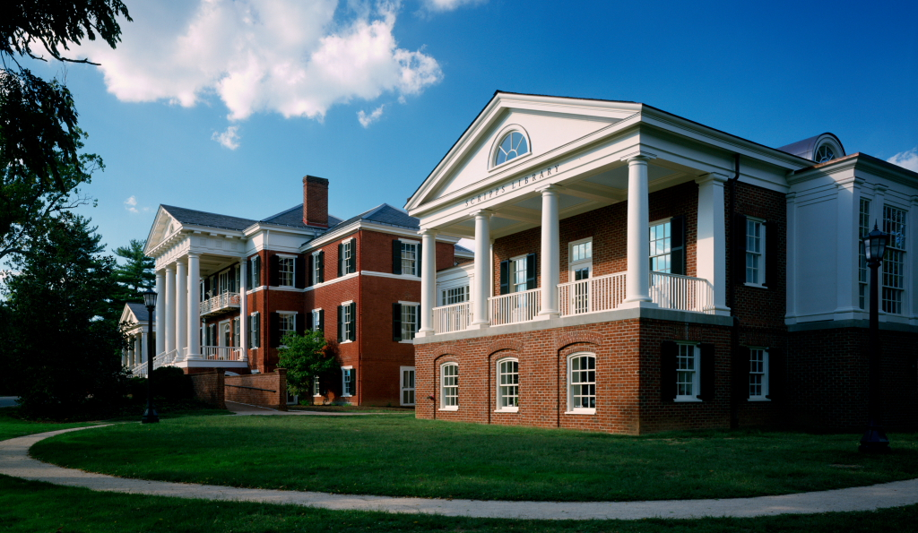

Slide 3
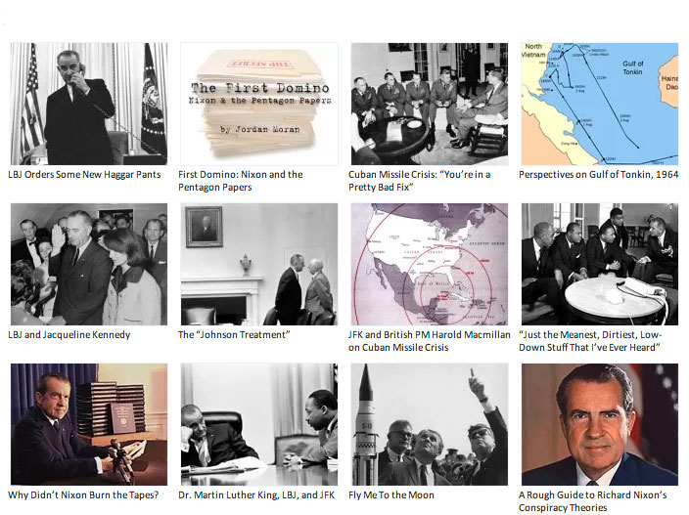

Slide 4
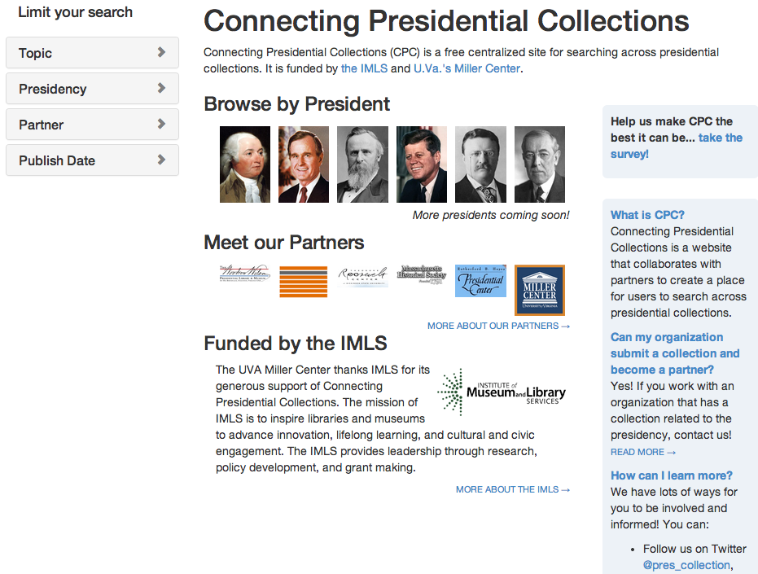
presidentialcollections.org

Slide 5
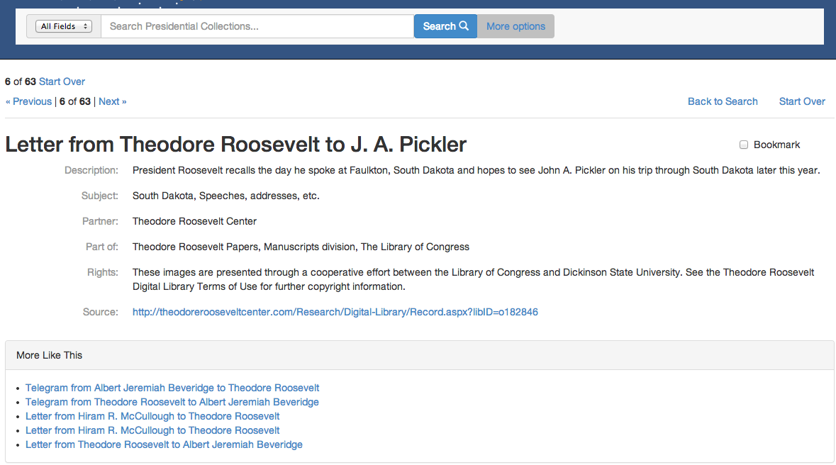

Slide 6
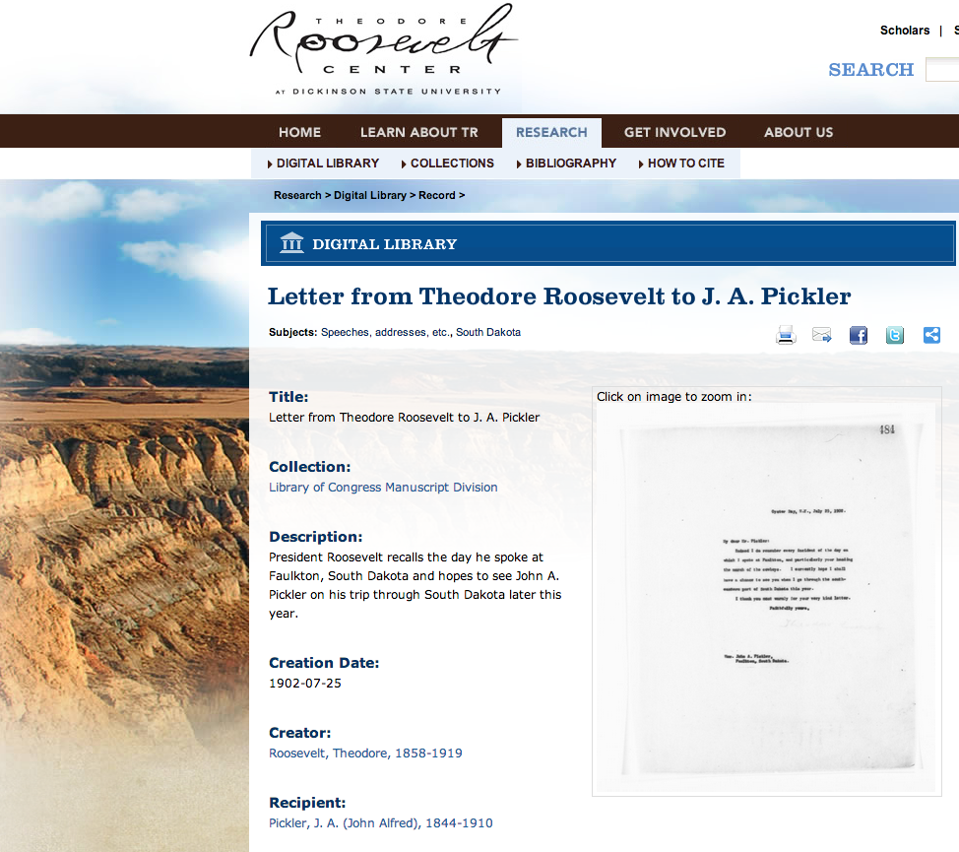

Slide 7
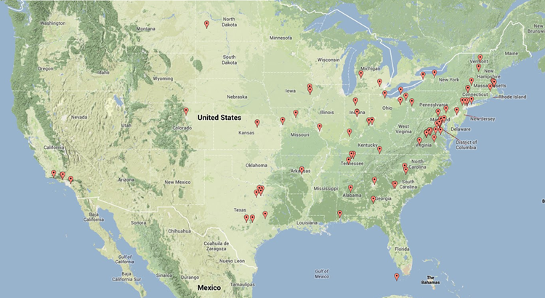

Slide 8
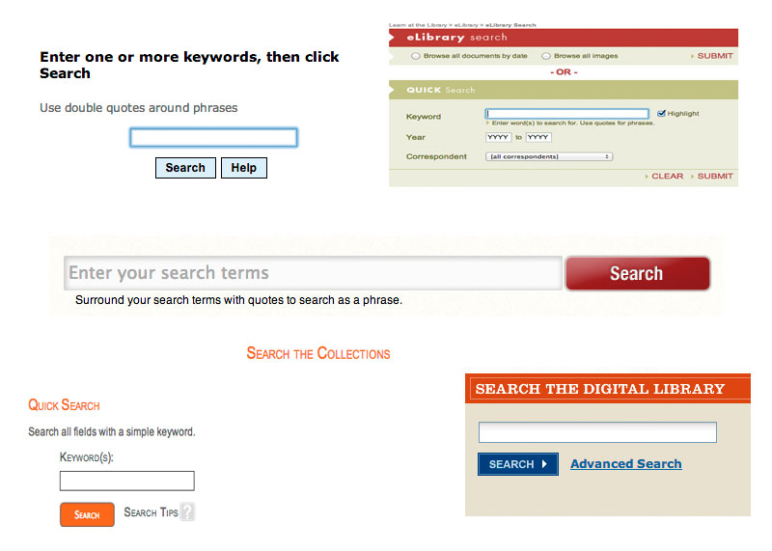

Slide 9


Slide 10
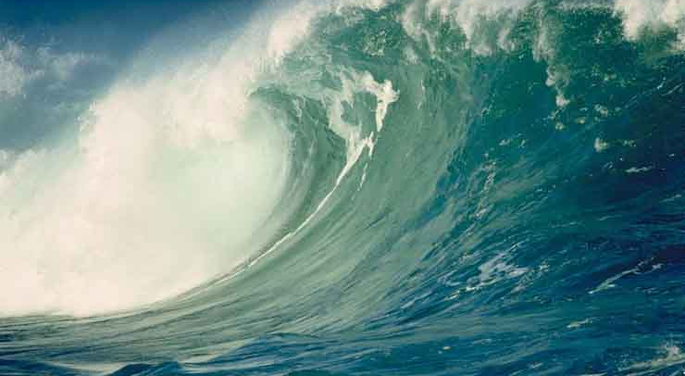

Slide 11


Slide 12
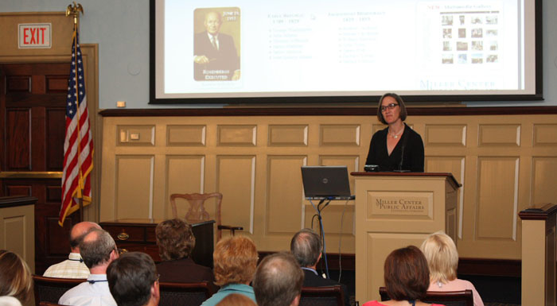

Slide 13


Slide 14


Slide 15
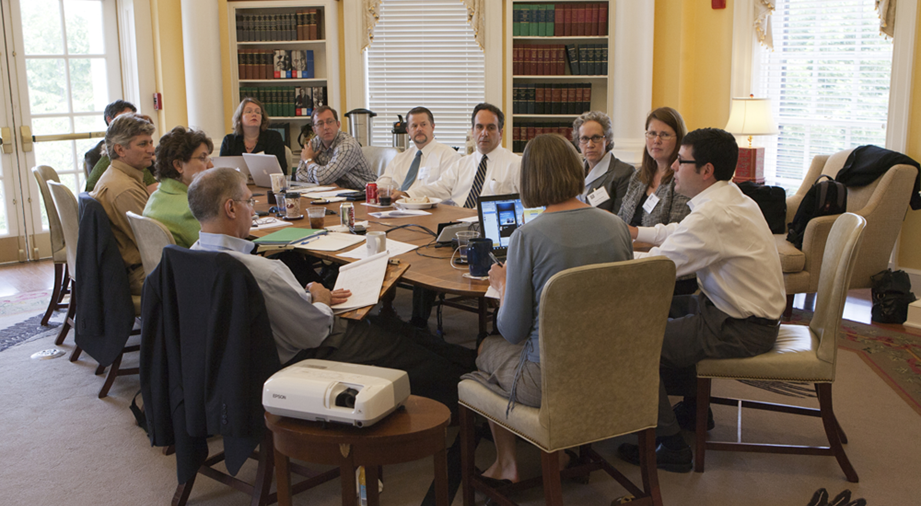

Slide 16



Slide 17
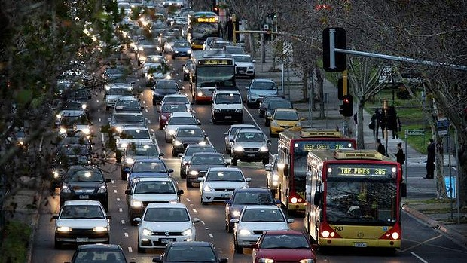

Slide 19


Slide 20
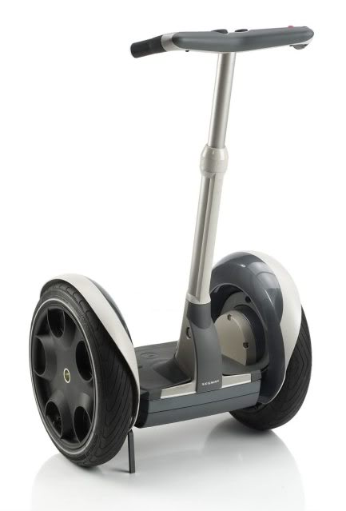
Matthew Stephens
Notes:
I will segue to Matthew will give you an overview of how the CPC website works, and how we aggregate data from presidential sites and libraries.

Slide 21
How are we doing this?
Notes:
Hi everyone! I’m happy to give you an overview of how the CPC website works, the technology involved and some of the features of our site.

Slide 22

What we’re doing
Data aggregation vs. site aggregation
Notes:
We’re providing an aggregation of partner data, not interacting with partners’ own search engines. This means there are no technological barriers to joining, and partners are free to continue to develop their online presence as they see fit. We’re providing a simple, easy to use search engine to bring researches in contact with disparate collections. Your site, your data, your items.

Slide 23
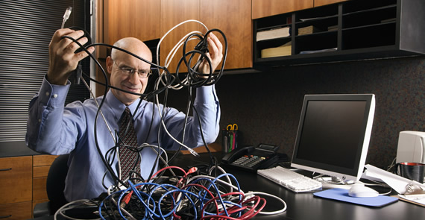
The Technology
Notes:
So let’s take a look at some of the technologies involved in this.

Slide 24
The Technology
Notes:
Off-the-shelf components, tried and tested code from Open Source community.

Slide 25

The Technology
Notes:
Ruby on Rails is a well-known web framework, full-featured and easy to develop and maintain. It provides the interface users see when they visit the CPC site.

Slide 26

The Technology
Notes:
Apache Solr is an open-source search engine, offering a powerful and flexible index for storing and seeking information. All CPC data we receive from partners is indexed and user searches are returned and displayed to the browser.

Slide 27

The Technology
Notes:
Connecting these two frameworks is Blacklight, another Open-Source software package, built and maintained by librarians and library technologists. It is commonly used as part of an Online Public Access Catalog, and we found it a good tool for CPC.

Slide 28

The Technology
Notes:
Finally, we have included Twitter’s Bootstrap styling library, which give the CPC site its look and feel. Together these tools, built and tested by countless developers, give us what we sought: fast, useful searching; a full-featured web site; mobile-friendly, responsive design.

Slide 29
Notes:
The result is an easy-to-use search portal, directing users to your sites.

Slide 30
Smoothing rough edges

Slide 31
Smoothing rough edges
Convert records to XML
Notes:
Transform data rec’d from partners; find ways to standardize the data (MODS, lcnaf); trust Solr to return relevant results

Slide 32
Smoothing rough edges
Convert records to XML
Use authoritative names
Notes:
Transform data rec’d from partners; find ways to standardize the data (MODS, lcnaf); trust Solr to return relevant results

Slide 33
Smoothing rough edges
Convert records to XML
Use authoritative names
Fast & powerful search engine
Notes:
Transform data rec’d from partners; find ways to standardize the data (MODS, lcnaf); trust Solr to return relevant results

Slide 34
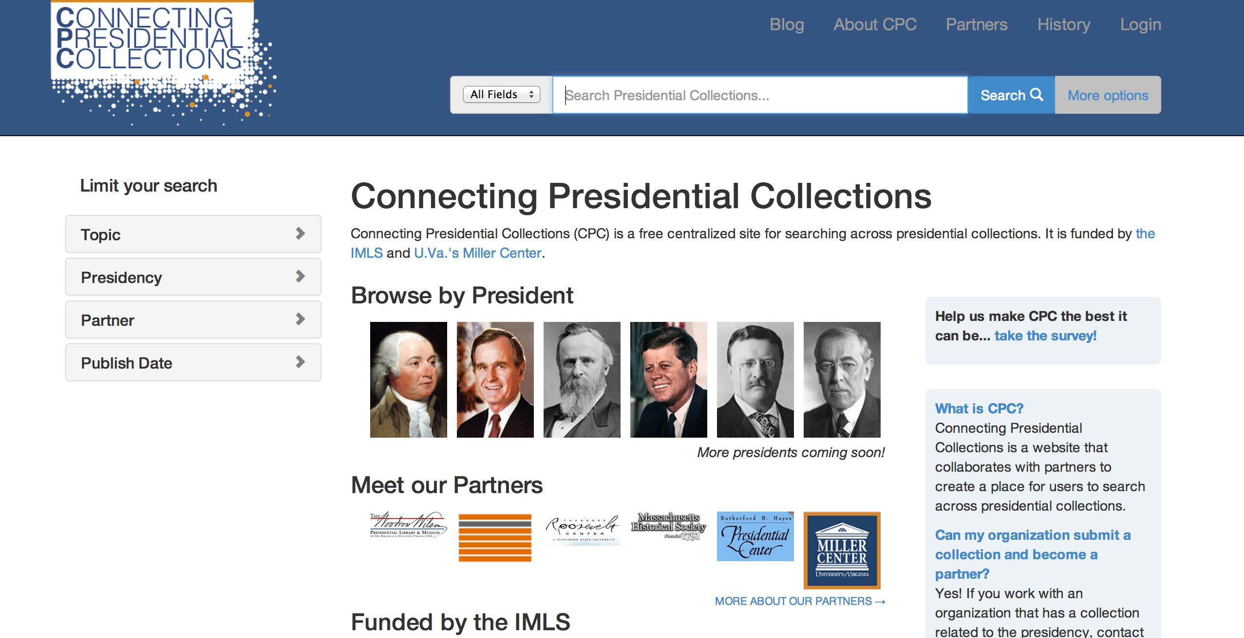
Demo!
Notes:
Keyword search; Author/Title/Subject; Facets (aspects of aggregated data); Advanced search; 11,000 records – site gets better as data increases.

Slide 35
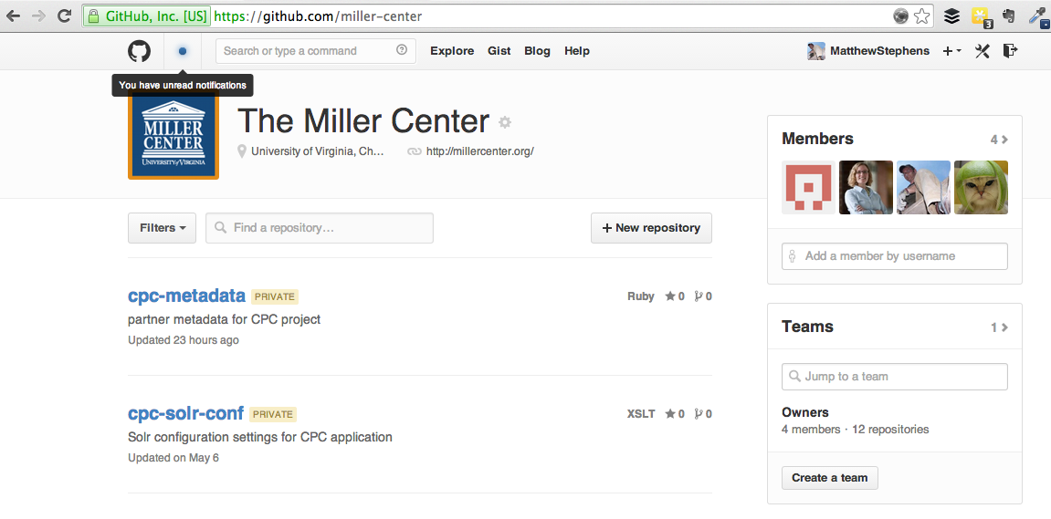
Be sociable, share!
Notes:
11,000 records; GItHub!! Collaboration; feature development

Slide 36
Amber Lautigar Reichert
Notes:
And now Amber will explain what is involved in partnering with CPC

Slide 37


Slide 38
Metadata

Slide 39
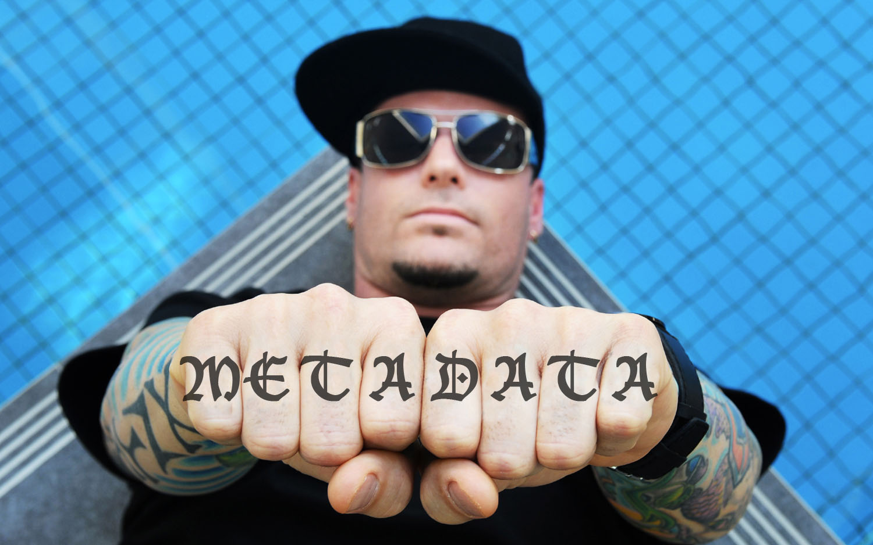
http://www.knuckletattoos.co.uk/tattoo/metadata/#metadata

Slide 40

Metadata!

Slide 41
Metadata

Slide 42
Required Metadata
Title
Description
Dedicated URL
Optional:
Date, Type, Format, Author, Keywords, etc.

Slide 43
XML: Dublin Core (OAI)
<oai:record>
<oai:header>
<oai:identifier/>
<oai:datestamp/>
</oai:header>
<oai:metadata>
<oai_dc:dc>
<dc:id>poh_114</dc:id>
<dc:identifier>poh_114</dc:identifier>
<dc:publisher>Miller Center Oral History Program</dc:publisher>
<dc:contributor>UVA: James Sterling Young, Chair; Stephen F. Knott</dc:contributor>
<dc:description>Charles Wick recounts his eight-year tenure as Director of the U.S. Information
Agency.</dc:description>
<dcterms:hasPart/>
<dc:date>April 24-25, 2003</dc:date>
<dc:title>Wick, Charles Z.</dc:title>
<dc:source>http://millercenter.org/president/reagan/oralhistory/charles-wick</dc:source>
</oai_dc:dc>
</oai:metadata>
</oai:record>

Slide 44
CSV
"ObjectID","Object Number","Classification","Object","Permalink","Creator","Title","Dated","Medium","Credit Line","Dimensions","Description","Rights"
"5135","1994.001.0009.0002","Documents","Document","http://eMuseum.jfk.org/view/objects/asitem/items@:5135","Dr. Malcolm O. Perry","Dr. Malcolm Perry's Statement of Activities",
"5133","1994.001.0009.0001","Documents","Document","http://eMuseum.jfk.org/view/objects/asitem/items@:5133","Dr. Robert McClelland","Dr. Robert McClelland's Statement of Activit
"28973","2006.030.0005","Artifacts","Brush","http://eMuseum.jfk.org/view/objects/asitem/items@:28973","","Fingerprint brush","circa 1960",""Wood, Hair, String"",""Lt. J. C. ""Ca
"22628","2003.021.0001","Documents","Card","http://eMuseum.jfk.org/view/objects/asitem/items@:22628",""Jefferies & Manz, Inc."","Funeral mass card for President John F. Kennedy"
"27520","2008.016.0001","Films",""Film, 8mm"","http://eMuseum.jfk.org/view/objects/asitem/items@:27520","Dr. George Christian","George Christian Film","11/25/1963","Film","Georg
"3544","1989.100.0016.0016","Photographs","Negative (b&w)","http://eMuseum.jfk.org/view/objects/asitem/items@:3544","Dallas Times Herald","Image of Lady Bird Johnson leaving Par
"3550","1989.100.0016.0019","Photographs","Negative (b&w)","http://eMuseum.jfk.org/view/objects/asitem/items@:3550","Dallas Times Herald","Image of Malcolm Kilduff announcing th
"3560","1989.100.0018.0001","Photographs","Negative (b&w)","http://eMuseum.jfk.org/view/objects/asitem/items@:3560","Dallas Times Herald","Image of Dallas Police officers standi
"3668","1989.100.0023.0011","Photographs","Negative (b&w)","http://eMuseum.jfk.org/view/objects/asitem/items@:3668","William Allen","Image of Dallas Police Lieutenant Carl Day p
"3720","1989.100.0025.0002","Photographs","Negative (b&w)","http://eMuseum.jfk.org/view/objects/asitem/items@:3720","William Allen","Image of Dallas Police officers outside the
"4045","1989.100.0041.0002","Photographs","Negative (b&w)","http://eMuseum.jfk.org/view/objects/asitem/items@:4045","Dallas Times Herald","Image of police officers guarding the
"22056","2002.004.0005","Photographs","Slide","http://eMuseum.jfk.org/view/objects/asitem/items@:22056","Jay Skaggs","Image of bystanders in Dealey Plaza shortly after the assas
"22067","2002.004.0016","Photographs","Slide","http://eMuseum.jfk.org/view/objects/asitem/items@:22067","Jay Skaggs",""Image of Lt. J. C. ""Carl"" Day holding rifle outside the

Slide 45
Excel
Title | Date | Author | Description | URL
Pizza Slice | 5/5/14 | Doris | Pizza Slice with side of seasoned greens, fresh fruit. | http://school-lunch-archive.com/20140505
Baked Spaghetti | 5/8/14 | Joshua | Baked Spaghetti with fresh roll. Side: fresh broccoli salad, fresh fruit. | http://school-lunch-archive.com/20140508
Burger | 5/12/14 | Doris | Build a burger on a bun. Sides: broccoli and cheese, fresh veggies, fresh fruit. | http://school-lunch-archive.com/20140521
Chicken Fajita | 5/21/14 | Annette | Chicken fajita wrap with black beans or romaine lettuce salad. Choice of fresh fruit. | http://school-lunch-archive.com/20140521
Diced Chicken | 5/14/14 | John B. | Diced chicken with gravy, mashed potatoes, seasoned spinach. Choice of fresh fruit. | http://school-lunch-archive.com/20140514

Slide 46

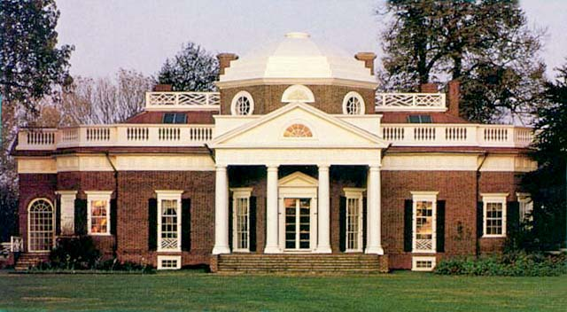
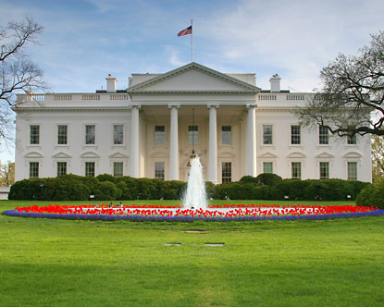
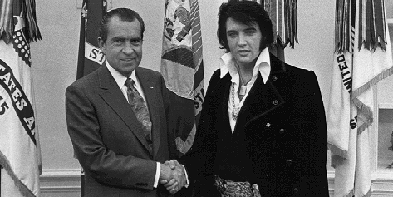
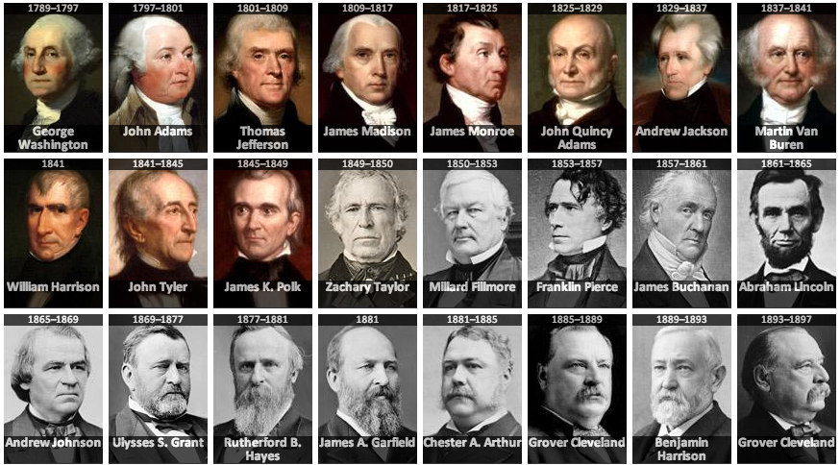
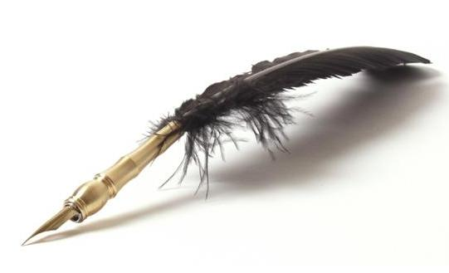

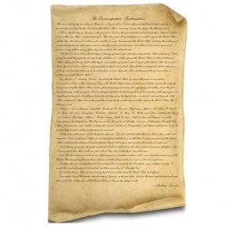

Slide 47
“Format”
4 x 5 in
8 x 10 in
11 ¼ x 8 ¾ in (28.6 x 22.2 cm)
10.051 inches long
0 inches long
120 minutes
8 minutes
Gauge: 8 mm; Speed: 12 fps

Slide 48
All types of “format” field content
99 9/9 x 9 /9 in. (99.9 x 99.9 cm)
9 9/9 in. (9.9 cm)
Gauge: 9mm; Speed: 99 fps
99 9/9 x 9/9 in. (99.9 x 99.9 cm)
9 9/9 x 9 9/9 x 9/9 in. (9.9 x 9.9 x 9.9 cm)
Gauge: 9mm; Speed: 9 fps
9 x 9 in. (9.9 x 9.9 cm)
Outer: 9 x 9 9/9 x 9 9/9 in. (9.9 x 9.9 x 9.9 cm)\nInner: 9 9/9 x 9 9/9 x 9 in. (9.9 x 9.9 x 9.9 cm)
99 Minutes
999 Minutes
999.999 inches long
999.999 inches wide
999.999 inches high
0 inches wide
0 inches high
0 inches long

Slide 49


Slide 50

Metadata!

Slide 51
XSLT
(Extensible Stylesheet Language Transformations)
RegEx
(Regular Expressions)
Solr

Slide 52

Manual Cleanup

Slide 53




Smoothing rough edges
csv,xls,??
XML
Notes:
Transform data rec’d from partners; find ways to standardize the data (MODS, lcnaf); trust Solr to return relevant results. CPC further groups and organizes data (e.g. date ranges)

Slide 54
in → inches
12 January → January 12
+ Your org name or geographic data
(etc.)

Slide 55
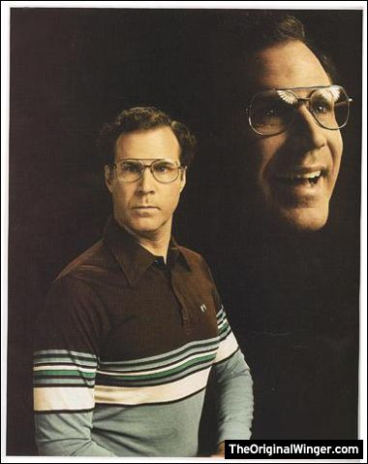
We’re here to make you look good.

Slide 56
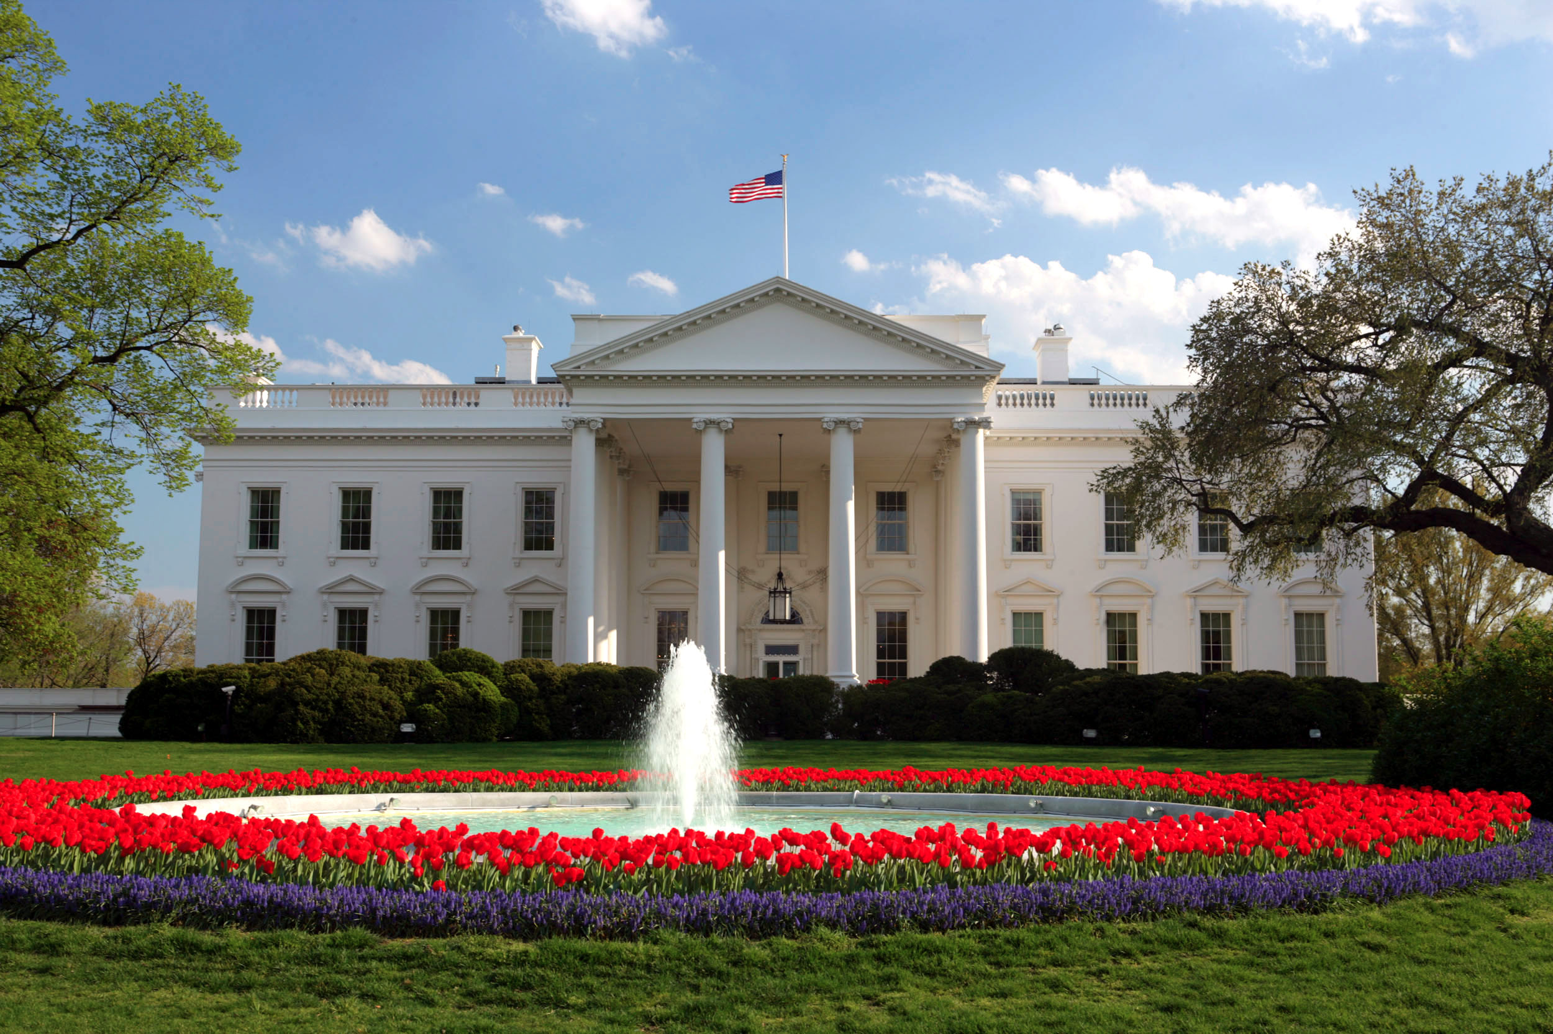

Slide 57
Ideal partners have…
100% digitized collection(s),
that are fully available online,
are clearly focused on the presidency,
and have a complete and clear digital metadata record about each item.

Slide 58


Slide 59
I want to be a partner! But…
I don’t have digital records
We only have a few digital items
What’s metadata?
Our IT person was eaten by a bear and I don’t know how to export from the system.
I don’t have time for this!

Slide 60
Educational Materials

Slide 61





Slide 62
Goals:
Empowerment
Efficiency
Open Source / Open Data

Slide 63

A rising tide raises all boats.

Slide 64

Take the survey!
Paper copy in your seat
OR
presidentialcollections.org

Slide 65
Reference Topics?
Metadata
What is open source/open data?
Copyright in the digital age
Best practices for scanning
Budget solutions for digital development
Solr/Blacklight
Other ideas? We want to hear from you!

Slide 66

We’re listening!

Slide 67
Take the survey!
Paper copy in your seat
OR
presidentialcollections.org

Slide 68
Michael Greco
Notes:
And now Michael will talk to us about the larger vision of CPC

Slide 69
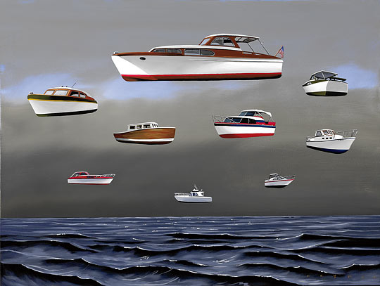
A Rising Tide Lifts All Boats

Slide 70
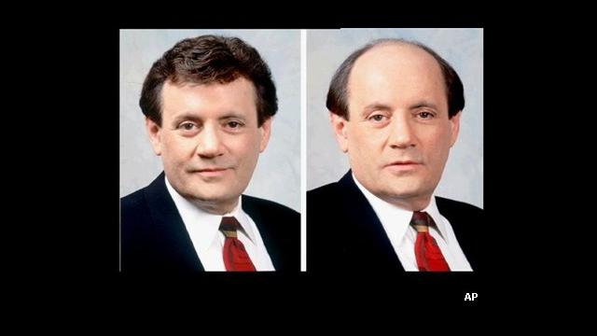
I am not just the President, I am a client

Slide 71
It’s free!!!

Slide 72
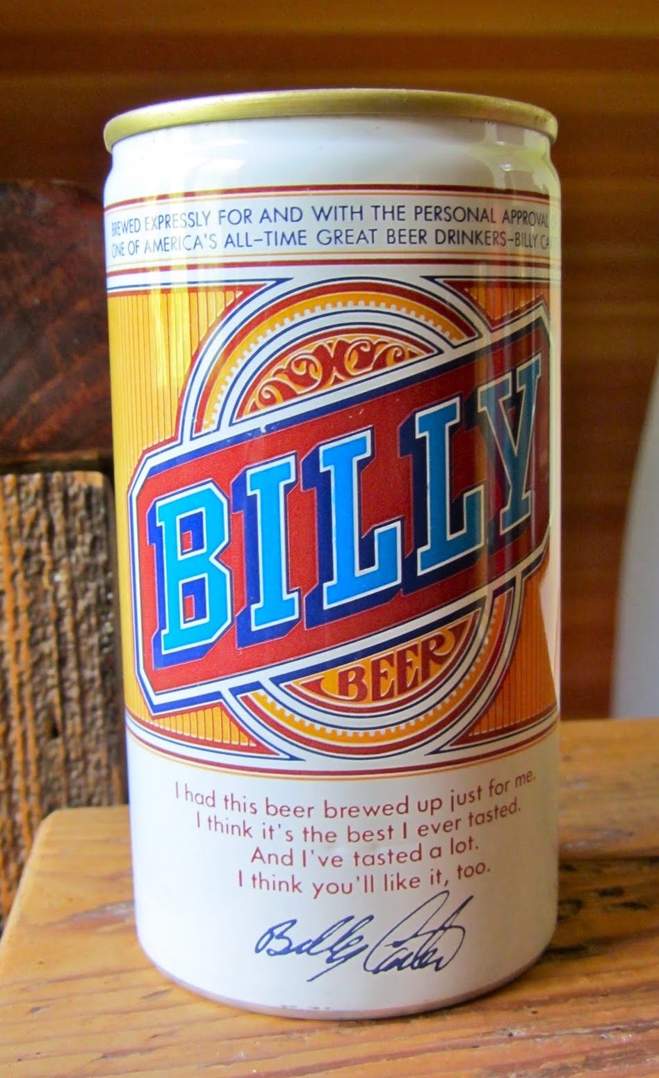
Not free like beer….

Slide 73
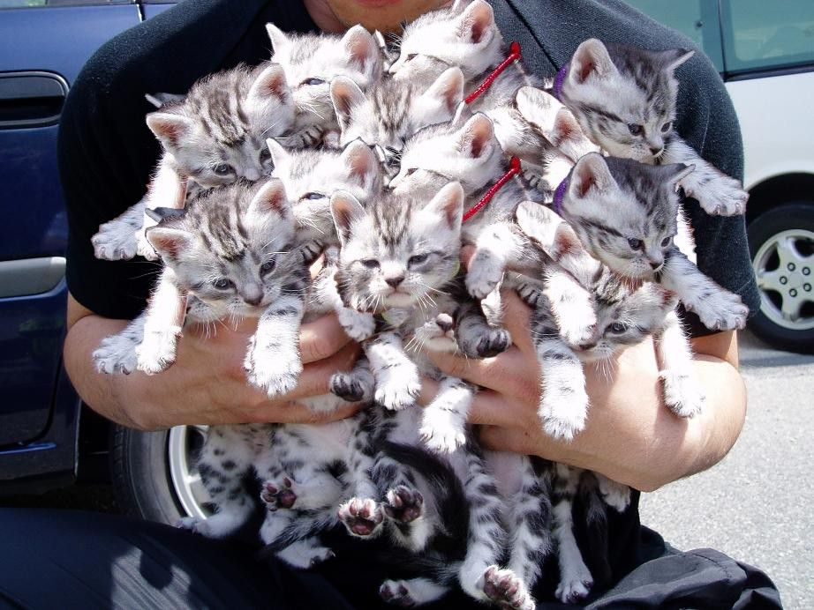
…It’s free like kittens

Slide 74
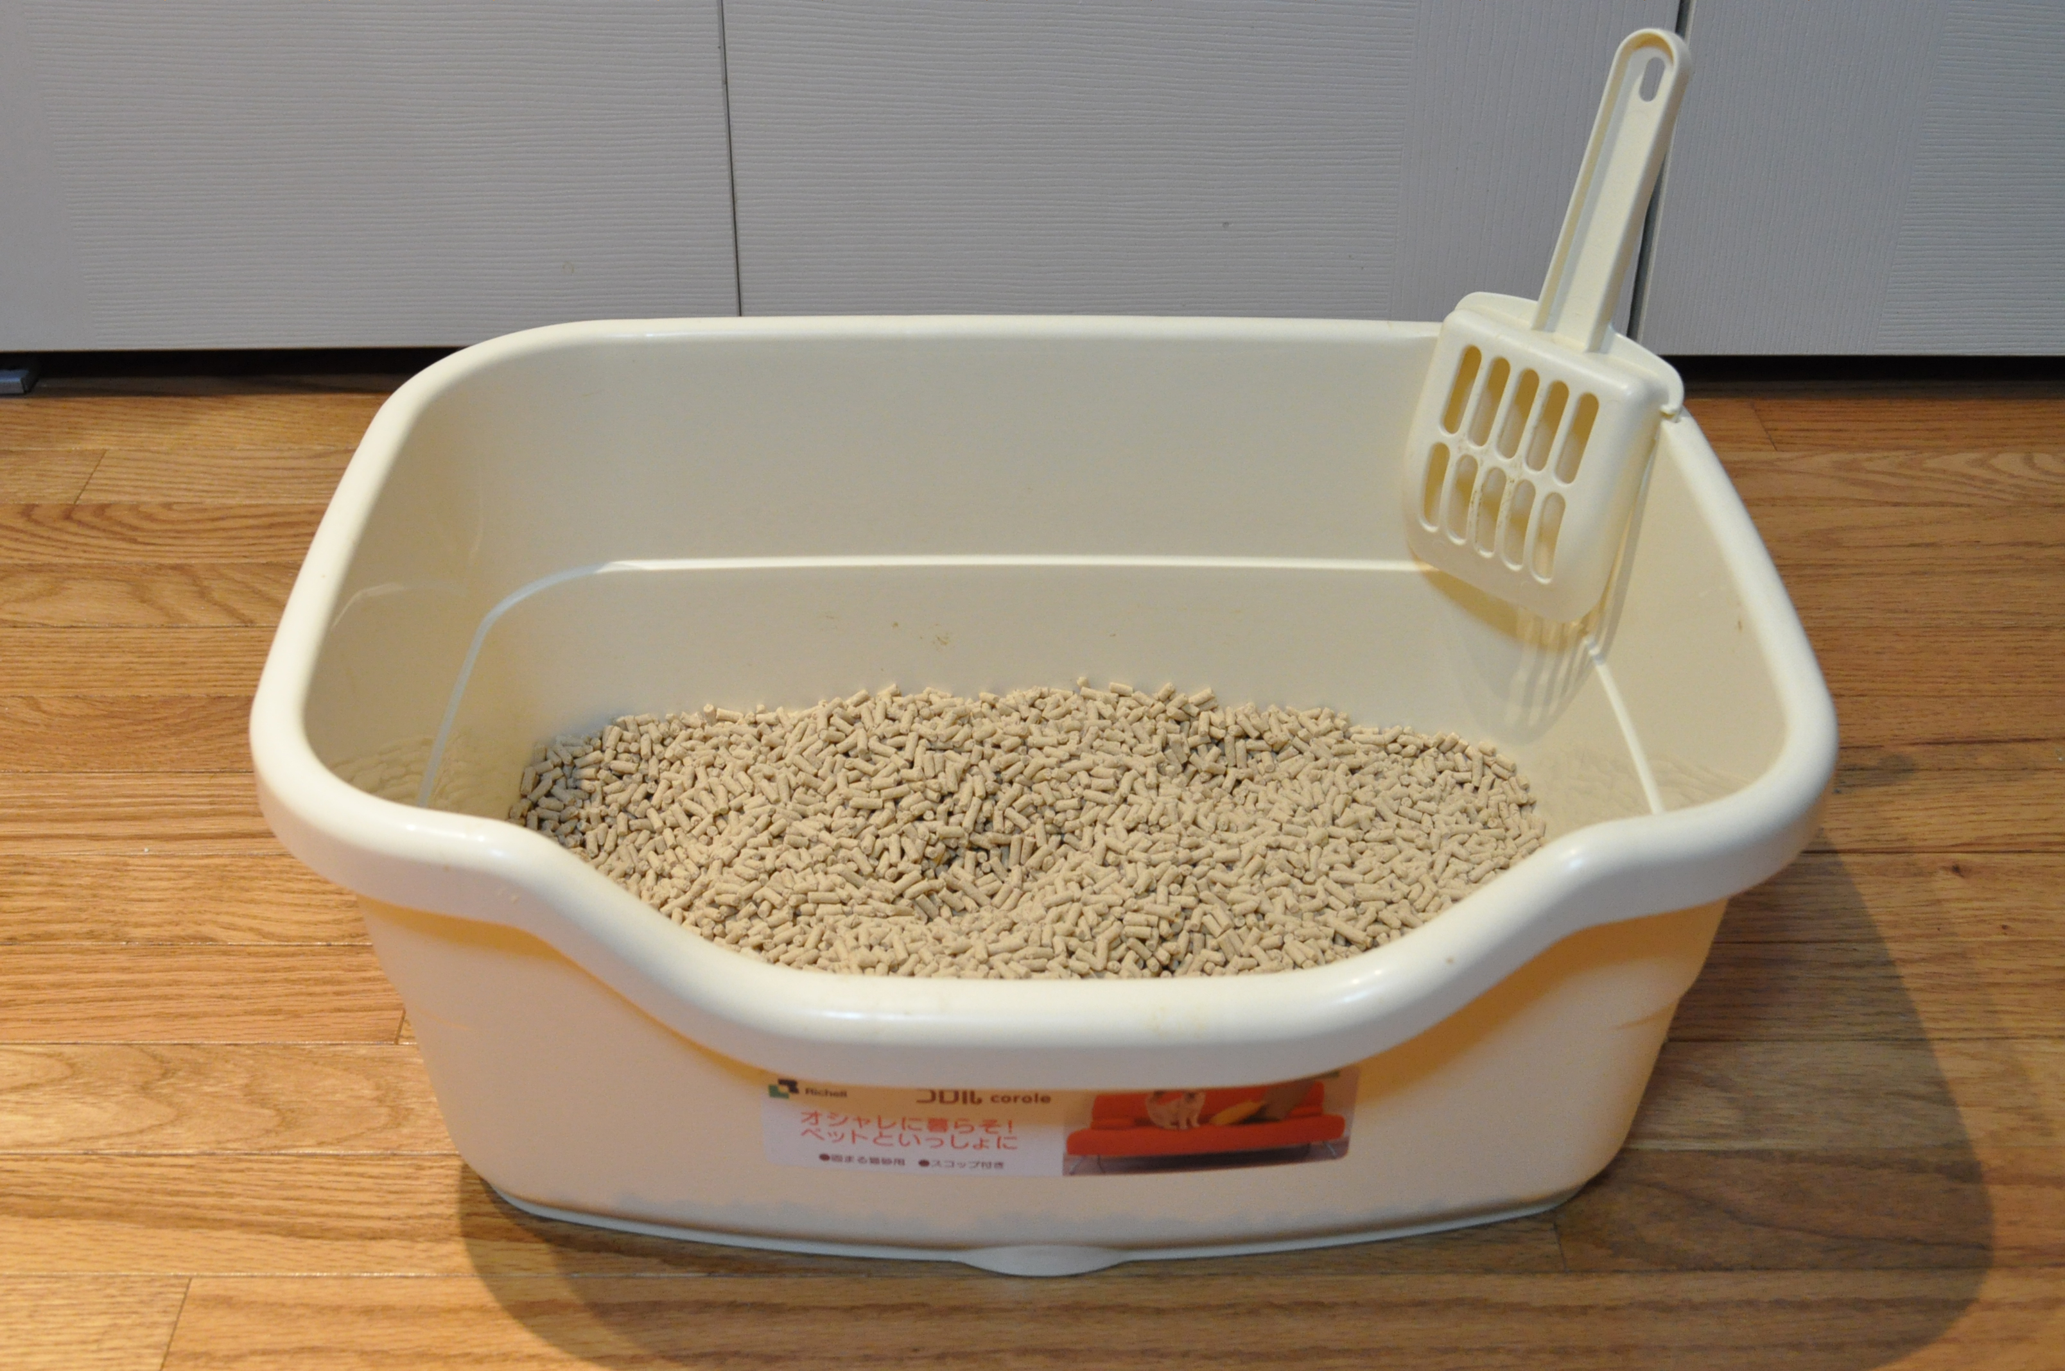
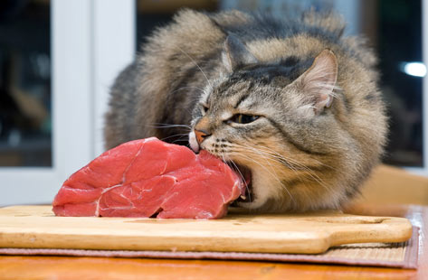
Care & Feeding

Slide 75
We are here to help.

Slide 76
We won’t steal your stuff.

Slide 77

Presidentialcollections.org is a free centralized site
for searching across presidential collections.
Questions?
presidentialcollections@virginia.edu
http://twitter.com/pres_collection

